Slide 1
5 V&V
Ref: Law & Kelton, Chapter 5

Slide 2

It is very simple to create a simulation.
It is very difficult to model something accurately.
In this lecture we will investigate ideas of model verification, validation, and credible models

Slide 3
Outline
Determining the level of simulation model detail
Verification
  Building the model right
Validation
  Building the right model
Accreditation
  Certification of M&S by an independent agency
  DOD spends more than 1B$ on sponsoring M&S

Slide 4
More M&S Jargon
Conceptual model
  Is the mathematical/logical/verbal representation (mimic) of the problem entity developed for a particular study.
  Developed through analysis and modeling phase
Computerized model
  Is the conceptual model implemented on a computer
  Developed through computer programming and implementation phase

Slide 5
Guidelines for determining the level of detail in simulation model
What to include, what to ignore safely?
Define the issues to be investigated using the model and the measures of performance that will be used for evaluation
  a model of a manufacturing system designed to estimate the throughput may not be able to answer to how much work in process space required.
  A correct model to a wrong problem is useless
The entity that goes through the model does not have to be always the actual entity that goes through the real system
  Inventory example; An entity is created for each day and inventory operations are simulated

Slide 6
Guidelines for determining the level of detail in simulation model
It is not necessary to model each part of the system in full detail;
  If you are simulating use of a bank’s parking space, you may take the bank itself as a delay or waiting station without simulating the operations inside in detail.
Start with “moderately detailed” model and add detail later on as needed by interacting with SMEs
  Simulation of a manufacturing plant
    Start with assuming unlimited WIP space and one type product
    Add buffer space limitation between machine and add multiple product type
    Add machine breakdowns and so on.

Slide 7
Guidelines for determining the level of detail in simulation model
Consulting with people familiar with system and sensitivity analysis to determine the part of the system or the parameters that affects the performance measure of interest most. More detail for important parts of the system
  A bottleneck machine is the one that determines the throughput in a production system
The level of available data can limit the level of detail one can include;
  Arrival times. Is the arrival times recorded based on urgent vs. non-urgent customers? We can model the system in different ways depending on the answer
  Simulation of a new system; less detail vs. Simulation to “fine-tune” an existing system

Slide 8
Guidelines for determining the level of detail in simulation model
If the number of factors are large, we should determine the factors that are really important using
  An analytical tool under simplifying assumptions
  Design of experiments using a simpler “rough-cut” simulation model
  Example; Is absenteeism of workers an important factor to include in the simulation? Can we assume that the parallel machines in the system are identical or we have to include them in the model as different machines? (Try min and max values for the factor and decide whether it impacts the outcome significantly)

Slide 9
Some Definitions
Verification: The process of determining that the computerized representation of our system functions as intended.
Validation: The process of determining that the whether our model accurately represents the system under study.
Credible: The process of ensuring that decision makers believe in the results of your model.

Slide 10
System View
System
VALIDATION
Analysis
Conceptual Model
Programming
VERIFICATION
Program
Experimental runs
VALIDATION
“Correct” Results
Sell the decision
ESTABLISH
CREDIBILITY
Implementation

Slide 11
In a Picture
Credible
# of persons
Difficulty
Time
Importance
Validated*
Verified*
*Necessary, but not sufficient conditions

Slide 12
Verification, Validation & Credibility
Is the PROGRAM correct?
Is the program a correct MODEL?
Is the model correct with respect to
the QUESTIONS or DECISIONS under investigation?
Are the decisions ROBUST?
What is the decision’s SENSITIVITY to the parameters?

Slide 13
Verification and Validation
Verification; determining whether the conceptual model has been correctly translated into a computer program
  Debugging the program
  Tedious job for big complex models
Validation; determining the simulation model as a whole is an accurate representation of the real system

Slide 14
Credibility
Credibility; whether the decision maker (DM) (client, manager) accepts the simulation model and its results as correct or not.
Following helps establishing credibility
  Make sure the DM understand the model assumptions
  Explain the validation and verification process
  Involve the DM throughout the project
  Reputation of the simulation analyst

Slide 15
Verification
When building models build and test it piece by piece or module by module.
  Start with “rough” model add detail as needed.
  Use “dummy” model parts for the non-modeled part of the system
    Example; Model the processes coming before the bottleneck machine as a box with random delay
Make sure more than one person checks the program.
  Group of involved people together go through the program (Structured walk-through)
Run the program under different settings and check if the results are as expected.
  Example; for any system, utilization = arrival rate/(Total service Rate) (Little’s formula). Under constant arrival rate to the system, if we increase the probability that parts reaches a particular process in the system, utilization of that process should be increasing and should be roughly given by the formula above.

Slide 16
Verification
4. Use trace option or interactive debugger available in many packages to check out what happens in the model event by event.
5. Run the model under simplifying assumptions for which analytical solutions are available for comparison.
  Exm; A job shop with multi workstation, multiple machines in each work station, and multiple type jobs. Assume one type job, exponential interarrival and service times then you have a series of M/M/s queues. We have analytical expressions for M/M/s.
6. Observing the animation

Slide 17
Verification; Trace option
Simulation traces; Many simulation packages provide build in capabilities for tracing the simulation as it occurs
Diary on at time 0.000000
Step
TNOW = 0.000000
0.000000 Monitor-Progress event
Step
0.000000 CREATE (verify.net:1) Arrival of entity 1
ACTIVITY (verify.net:2) not released
release ACTIVITY #2(verify.net:3) dur. 0.000000
Step
Step
0.000000 ASSIGN Type_2(verify.net:13) Arrival of entity 1
release ACTIVITY (verify.net:14) dur. 0.000000
Step
Step
0.000000 COLCT (verify.net:15) Arrival of entity 1
release ACTIVITY #4(verify.net:16) dur. 3.008759
Step
3.008759 QUEUE QUEUE_2(verify.net:17) Arrival of entity 1

Slide 18
Perspectives on validation
Validity is the necessary condition for the model to be used as a decision tool.
Difficulty of validity process depends on the complexity of the system and whether or not the simulated system exist.
  Validating a neighbor bank model vs. a model for a weapon system to be developed.
Simulation can never be 100% valid representation of the real system. In many cases, it may not be cost effective to make the model “more valid”.

Slide 19
Perspectives on Validation
Validation is incorrectly treated as a distinct activity undertaken at the end of a project.
Validation is a process.
Validation should be started at the beginning of a project.
Validation requires the input of many people.
Validation is an exercise in human relations as well as a technical endeavour.

Slide 20
Validation Literature
There is a paucity of research on validation.
    (Finlay & Wilson, 1990. Orders of Validation in Mathematical Modelling. JORS, 41(2): 103-109)
No formal method can be applied in all cases and no absolute measure exists for complex models.
    (Law & Kelton, Simulation Modeling & Analysis, 1991)
The function of models is to influence decision makers. Thus acceptance by decision-makers may constitute de facto validation.
    (Butler, 1995. Management Science/Operations Research Projects in Health Care: The Administrator's Perspective. Health Care Management Review, 20(1): 19-25.)

Slide 21
Validation Literature
Some of the better literature talks about validation as being a process.
Ignazio and Cavalier suggest validation is a process of interacting with decision makers to build their confidence in model results.
    (Ignizio and Cavalier, Linear Programming, 1994)
Two main validation approaches:
  Law & Kelton
  Schellenberger

Slide 22
Techniques for increasing validity and credibility
Collect high-quality info and data on the system
Interact with the manager on a regular basis
Maintain an assumption document and perform a structured walk-through
Validate components of the model using quantitative techniques
Validate the output from overall simulation model
Animation

Slide 23
1 Collect high-quality info and data on the system
Conversations with different SMEs.
  Hard to find a single document or person that will answer all the questions.
  Carefully identify the true SME for each subsystem to avoid biased/erroneous data.
Observations of the system
  Data requirements (type, format, amount, etc.) specified precisely.
  Need to understand the process that produced the data
    Representative? Appropriate type/format? Errors in measuring/recording? Biased? Consistent?
Existing Theory
  Arrival process of the people to a service system is usually Poisson
Similar system simulation studies
Experience and intuition of the modeler
  To hypothesize how certain components of a system operate, particularly for non-existing systems

Slide 24
2 Interact with the manager on a regular basis; Benefits
Nature of the problem to be solved may become more clear as the study develops which will require re-formulation of objectives by the manager.
The managers involvement and interest is maintained
The interaction will increase the validity of the model
The interaction will increase the credibility since the manager knows and accepts the model assumptions

Slide 25
3 Maintain an assumption document and perform a structured walk-through
Assumptions document (conceptual model)
  Overview section
    Overall project goals
    Specific issues to be addressed by the simulation study
    Performance measure for evaluation
  Detailed description of each subsystem in bullet format and how the subsystems interact.
  A list of simplifying assumption and why they are made.
  Summaries of the data; mean, variance, and histogram of the data collected
  Sources of important/controversial information

Slide 26
3 Maintain an assumption document and perform a structured walk-through
Structured walk-through
  System description and assumptions are collected from different sources and they may contain errors
  Simulation analyst go through the conceptual model bullet by bullet in front of all the SMEs and people involved
  It will increase both validity and credibility of the model

Slide 27
4 Validate components of the model using quantitative techniques
Fitted input probability distributions
  Graphical checks or goodness-of-fit test
Merging several sets of data on the same random variable; Exm; Time-to-failure, time-to-repair data collected from two identical machines
  Statistical homogeneity test (Kruskall-Wallis)
Sensitivity analysis of factors; If a particular factor influences the performance measure of interest significantly we have to be careful in modeling this factor
  Value of a parameter, choice of the distribution, entity moving through the system, level of detail for a subsystem
  Have to use common random numbers when we are doing sensitivity analysis so that we can isolate the effect of the change in the factor. The change in the performance is due to the change in the factor not because of different random numbers used.
  Sensitivity of the performance to two or more factor; design of experiments needs to be carried out.

Slide 28
5 Validate the output from overall simulation model
The most definitive test; How close the simulation results resembles to real system results (results validation)
If we want to simulate a non-existing system, simulate the existing system and compare the results of simulation to the existing system result. If they are close enough modify the model for non-existing system
Statistical procedure to compare the results.
Turing test; Have people familiar with the system try to distinguish which are the results of simulation and which are real system’s results.

Slide 29
In short – practical validation techniques
By subjectively eyeballing results (of simulation, analysis, real or experimental).
  Eyeball plots of steady state, time series, progress, etc.
By taking the error % or delta % from theory or real.
Statistical
  L&K Basic Inspection and paired t-test

Slide 30
5 Validate the output from overall simulation model
If there are major discrepancies between simulation results and real system results either;
  The system is assumed to be working under certain conditions but it is not. Simulation may suggest an improvement in this case
  Certain conditions, constrains are missing in the model or some parameter values are wrong

Slide 31
Comparison of the model output to the real system;
Basic Inspection
Basic inspection is comparing a real system result with result of one run from simulation.
Assume that a real system produces time in system following N(150, 30²) and a simulation model of the system which gives values following N(140, 30²). Below are the results of 10 runs (replications). Obviously, simulation model is not a valid representation of real system
Runs | 1 | 2 | 3 | 4 | 5 | 6 | 7 | 8 | 9 | 10
Real Normal(150,30²) | 172.6 | 134.2 | 115.5 | 132.6 | 155.9 | 116.0 | 178.5 | 152.2 | 99.2 | 117.3
Simulation Normal(140,30²) | 136.8 | 159.3 | 118.1 | 119.6 | 112.9 | 121.6 | 164.8 | 126.8 | 95.0 | 147.4

Slide 32
Comparison of the model output to the real system;
Basic Inspection
Runs | 1 | 2 | 3 | 4 | 5 | 6 | 7 | 8 | 9 | 10
Real Normal(150,30) | 172.6 | 134.2 | 115.5 | 132.6 | 155.9 | 116.0 | 178.5 | 152.2 | 99.2 | 117.3
Simulation Normal(140,30) | 136.8 | 159.3 | 118.1 | 119.6 | 112.9 | 121.6 | 164.8 | 126.8 | 95.0 | 147.4
If we only looked at a single run, there is a 20% chance that we might be looking at run 3 or 9 and conclude that two systems give similar results and hence simulation model is valid.
If we happen to be looking at run 2 or 10, we might even think that simulation gives larger values, which is also a wrong conclusion

Slide 33
Comparison of the model output to the real system; Confidence Interval
We could simply develop a confidence interval on differences (Real-simulation). If the confidence interval contains 0, we cannot say that the two results are different. This is the paired-t test we have seen in output analysis.
Runs | 1 | 2 | 3 | 4 | 5 | 6 | 7 | 8 | 9 | 10
Real | 172.6 | 134.2 | 115.5 | 132.6 | 155.9 | 116.0 | 178.5 | 152.2 | 99.2 | 117.3
Simulation | 136.8 | 159.3 | 118.1 | 119.6 | 112.9 | 121.6 | 164.8 | 126.8 | 95.0 | 147.4
Difference (W) | 35.8 | -25.1 | -2.6 | 13 | 43 | -5.6 | 13.7 | 25.4 | 4.2 | -30.1
Mean (W): 7.17
Var(W): 578.91
t_{9,.95}: 1.833
90% C.I.
7.17 +/- 1.833*( 578.91/10)^{1/2}
= [-6.78, 21.12]

Slide 34
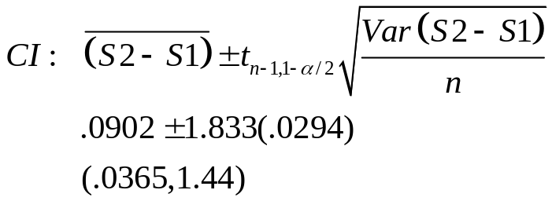
Confidence Interval Approach
Run | 1 | 2 | 3 | 4 | 5 | 6 | 7 | 8 | 9 | 10
Sys 1 ρ = .5 | .548 | .491 | .490 | .454 | .567 | .486 | .419 | .527 | .521 | .461
Sys 2 ρ = .6 | .613 | .618 | .630 | .732 | .548 | .614 | .463 | .614 | .463 | .572
Diff | .065 | .127 | .140 | .278 | -.019 | .128 | .044 | .087 | -.058 | .111
Mean (S2-S1): .0903
Var(S2-S1): .0086
s: .0930
t_{9,.95}: 1.833
Based on this test, we would assume that S2 and S1 are different.

Slide 35
Comparison of the model output to the real system; Confidence Interval
Based on this test, we could conclude that simulation model is valid since the interval contains zero
But we know that simulation model is not really valid here
Small number of data points is the reason for the wrong conclusion.
With more data points we should be able to conclude that simulation is not valid.
In reality, we don’t know what are the true mean for simulation and real system so we should always try to get as more data as possible.
As we have said paired-t test gives tighter C.I. if we have correlated outputs which is very hard to assure when comparing real-system output to simulation output.
Alternatively, we can use modified two sample-t-Welch C.I. to build the conf. interval

Slide 36
Comparison of the model output to the real system; Confidence Interval
90% C.I. using Welch (two sample t) approach
d.f.(f_cap)=17.34 use 17 => t(17, .95)=1.74
Avr(real)-Avr(sim.) +/- 1.74*[var(real)/10+var(sim.)/10]^{1/2}
7.17 +/- 1.74(702.63/10+474.0/10)^{1/2}
=[-11.7, 26.04]
Still we can wrongly conclude that real and simulation results are
statistically same or simulation model is valid. We need more data
in this example to make a correct decision.

Slide 37
A Summary Word
Almost all validation approaches assume the existence of a “real world” system to benchmark your model.
When no such system exists, you must be very methodical in your attempts to validate.
The Schellenberger framework can still be used and should guide your efforts.

Slide 38
Schellenberger Framework*
Validity has three dimensions:
  Technical validity: Comparison against a reasonable set of criteria.
  Operational validity: A subjective assessment of the behaviour of the model.
  Dynamic validity: The utility of a model over an extended period of time.
* Schellenberger, R.E., (1974). Criteria for Assessing Model Validity for Managerial Purposes. Decision Science 5(5): 644-653.

Slide 39
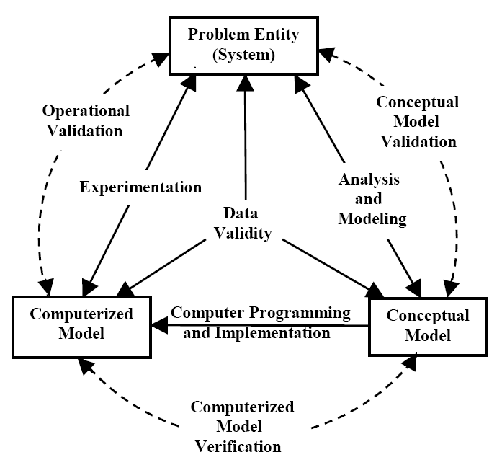
Paradigm for Model V&V

Slide 40
Technical Validity
Model Validity: The degree to which the underlying conceptual model of a system represents reality.
    List and vet mathematical, content, and causal assumptions.
Data Validity: The degree to which the data used in an instance of decision making is representative of reality.
    Accuracy, impartiality, and representativeness of the data.
    The accuracy of the process of data collection and aggregation.
Logical Validity: Describes the fidelity with which the conceptual model is translated to computer code.
Predictive Validity: The ability of the model to produce results that conform to expected output.

Slide 41
Operational Validity
Degree of Improvement: The robustness of the model results as suggested by the degree of improvement.
    If the model suggests a 60% improvement in performance for a particular option, the impact of error is likely to be insignificant.
Model Sensitivity: The effect of small change in data parameters on model stability.
  Sensitivity or “what-if” analysis is investigation of reaction of the model outputs to drastic changes model inputs or structure
    Poisson vs. ON-OFF traffic
      will the performance change?
      will change be at all load ranges: very low, low, moderate, high, very high?
    Queue size
    Queue discipline: FIFO vs. LIFO
  Implementability: The ability of the model to produce results that can be adopted in practice.

Slide 42
Dynamic Validity
Maintainability: The ease with which the model can be changed over time.
Review Process: The accuracy and completeness of the process of periodically reviewing the model to ensure continues to conform to reality.
Update Process: The accuracy and completeness of the process to periodically update model parameters.

